Slide 1





To our class
Let’s go 2A

Slide 2

Warm up
Let’s sing and dance

Slide 3


Tuesday, October 23rd, 2018
Unit 2 : My Things
Let’s Learn
A. Practice the words.
listening

Slide 4
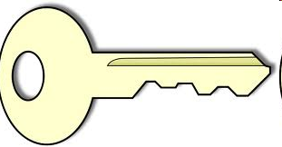
Tuesday, October 20th, 2015
Unit 2 : My Things
Let’s Learn
A. Practice the words.
a key

Slide 5
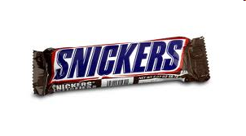
Tuesday, October 20th, 2015
Unit 2 : My Things
Let’s Learn
A. Practice the words.
a candy bar

Slide 6

Tuesday, October 20th, 2015
Unit 2 : My Things
Let’s Learn
A. Practice the words.
a comic book

Slide 7
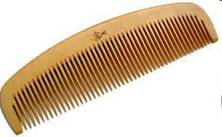
Tuesday, October 20th, 2015
Unit 2 : My Things
Let’s Learn
A. Practice the words.
a comb

Slide 8
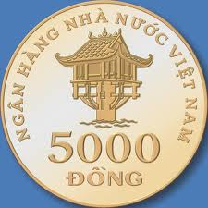
Tuesday, October 20th, 2015
Unit 2 : My Things
Let’s Learn
A. Practice the words.
a coin

Slide 9
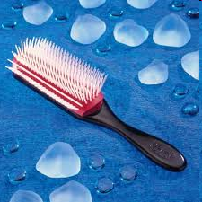
Tuesday, October 20th, 2015
Unit 2 : My Things
Let’s Learn
A. Practice the words.
a brush

Slide 10
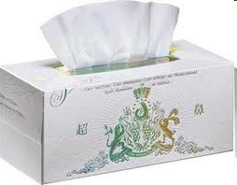
Friday, October 18th, 2014
Unit 2 : My Things
Let’s Learn
A. Practice the words.
a tissue

Slide 11
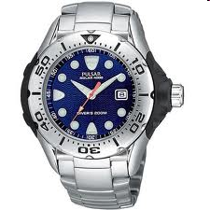
Friday, October 18th, 2014
Unit 2 : My Things
Let’s Learn
A. Practice the words.
a watch

Slide 12
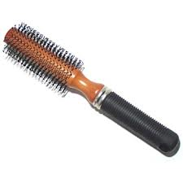
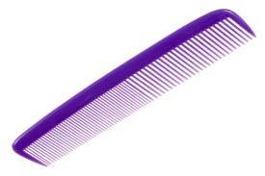
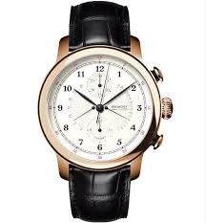
Friday, October 18th, 2014
Unit 2 : My Things
Let’s Learn
A. Practice the words.
a coin
a key
a candy bar
a brush
a comic book
a tissue
a comb
a watch

Slide 13
Tuesday, October 20th, 2015
Unit 2 : My Things
Let’s Learn
B. Practice the sentence.
listening

Slide 14
Tuesday, October 20th, 2015
Unit 2 : My Things
Let’s Learn
B. Practice the sentence.
Practice
I have a …….

Slide 15
I have a candybar
I have a brush
I have a comb
I have a watch

Slide 16
I have a key
I have a coin
I have a comicbook
I have a tissue

Slide 17
Lucky numbers
1
3
5
7
9
2
4
6
8
10

Slide 18
tissue / I / a / have
I have a tissue

Slide 19
have
I …… a comb.
a.has b.are c.have

Slide 20
………. coin
I have a coin

Slide 21
a / bar / have /candy /I
I have a candy bar

Slide 22
Lucky number
10 points.

Slide 23
have a watch
I......................

Slide 24
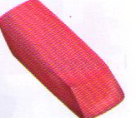
I have an eraser
I have ……. eraser
a.is b. an c. a

Slide 25
Lucky number
20 points

Slide 26
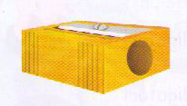
I have a pencilsharpener

Slide 27
I …………….. book
I have a comic book

Slide 28
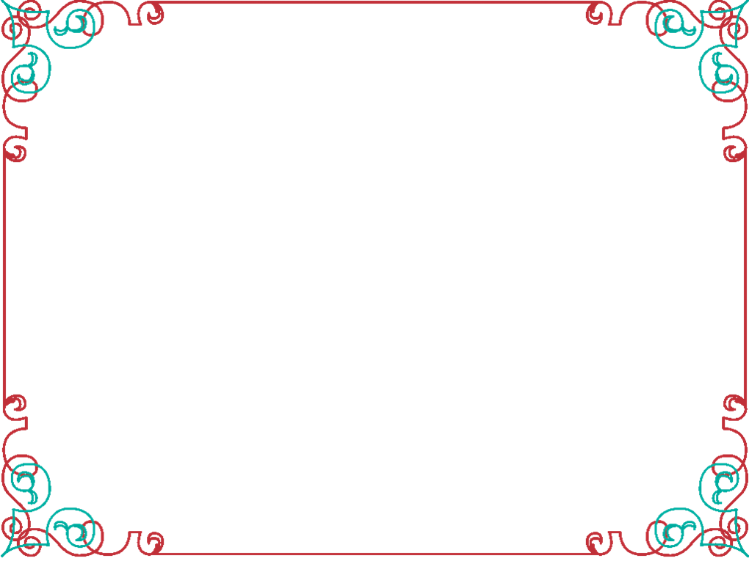

YOUR ATTENTION

