Slide 1
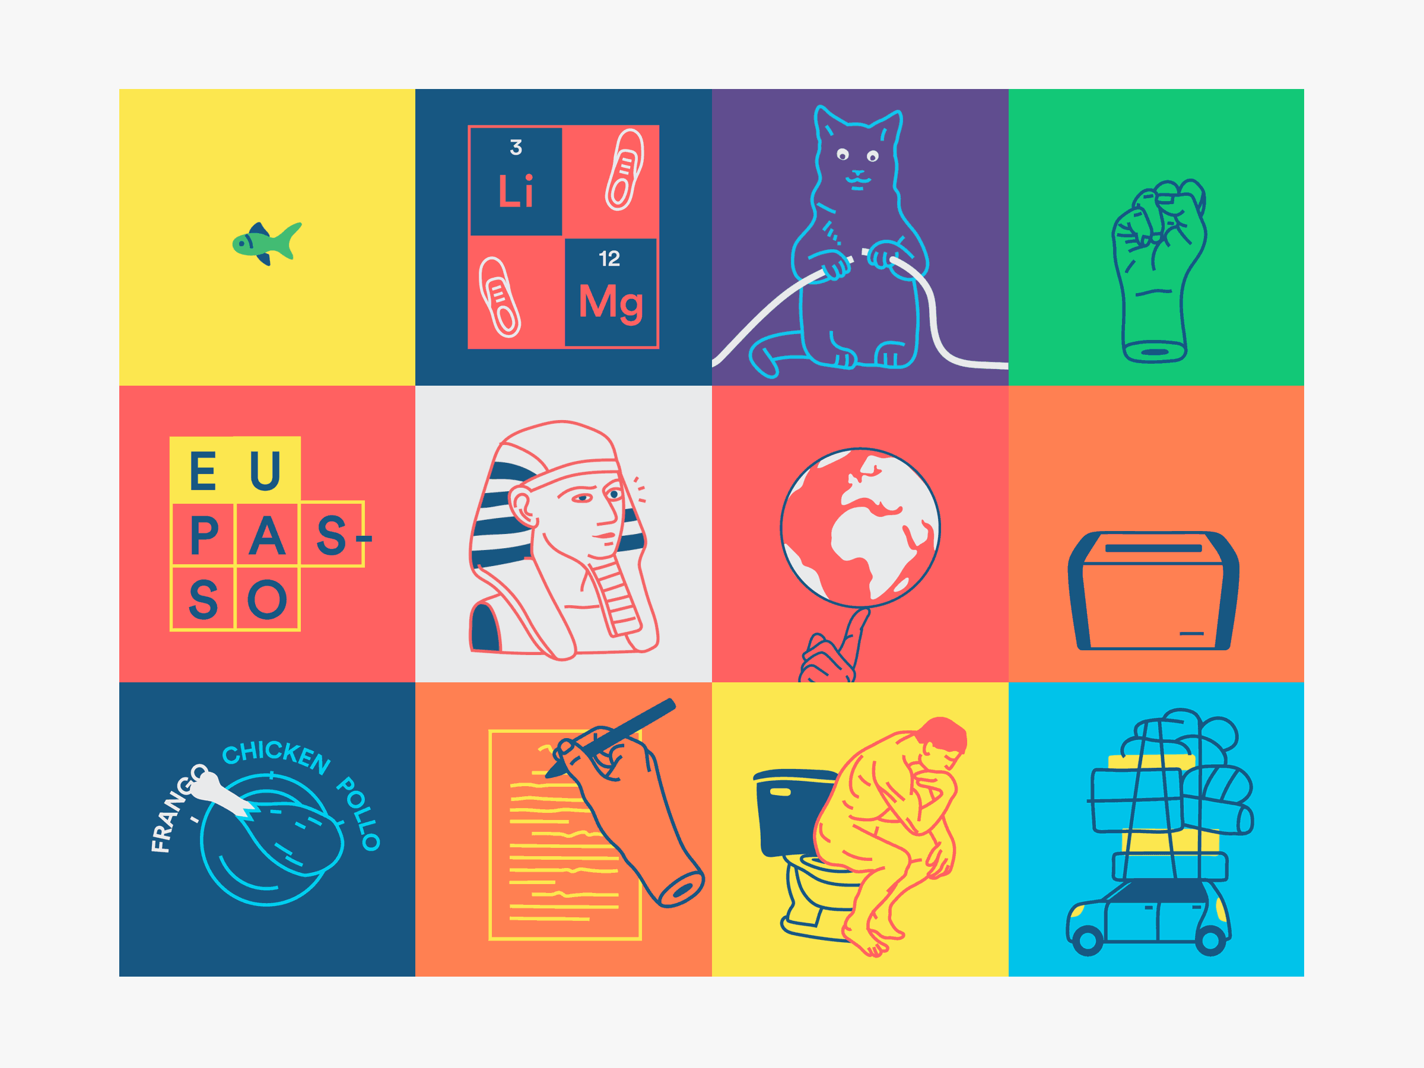
Unit 4:
We have English!
Grade 4
Lesson 2

Slide 2
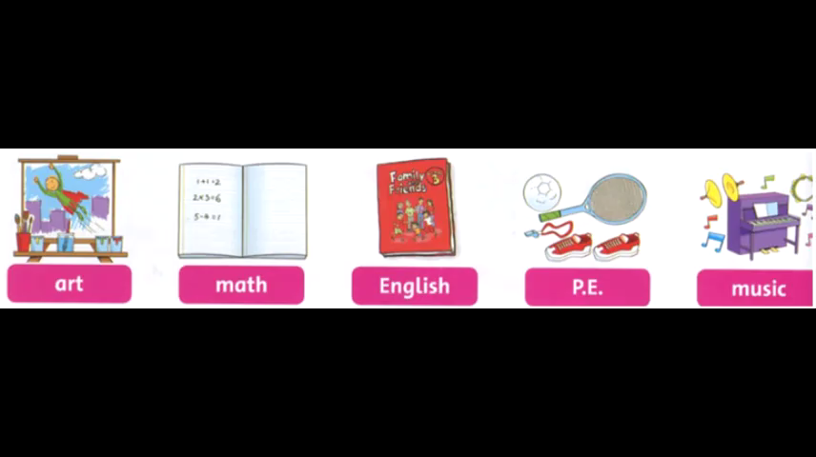

Slide 3
-Do :
I,you ,we ,they
What........?
-Does :
When.......?
He, She ,it
What do you have on Monday ?
I have Music on Monday
What do we have on Thursday ?
We have Math on Thursday

Slide 4
When do you have Art ?
I have Art on Tuesday
When do we have P.E ?
We have P.E on Friday

Slide 5

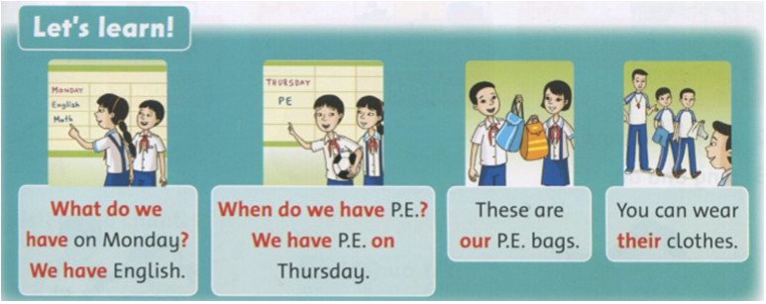

Slide 6
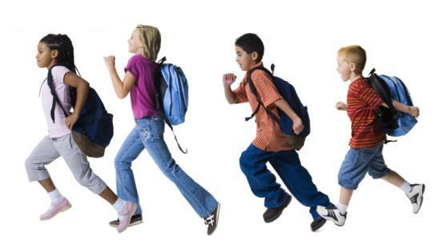
We have schoolbags.
These are our schoolbags.
we
- our

Slide 7
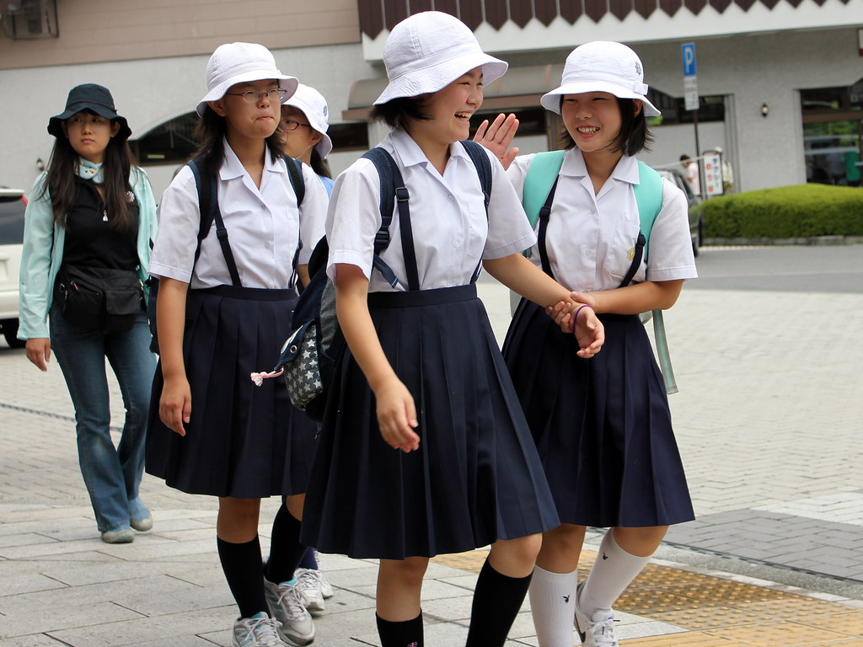
They have hats.
They wear their hats.
they
- their

Slide 8
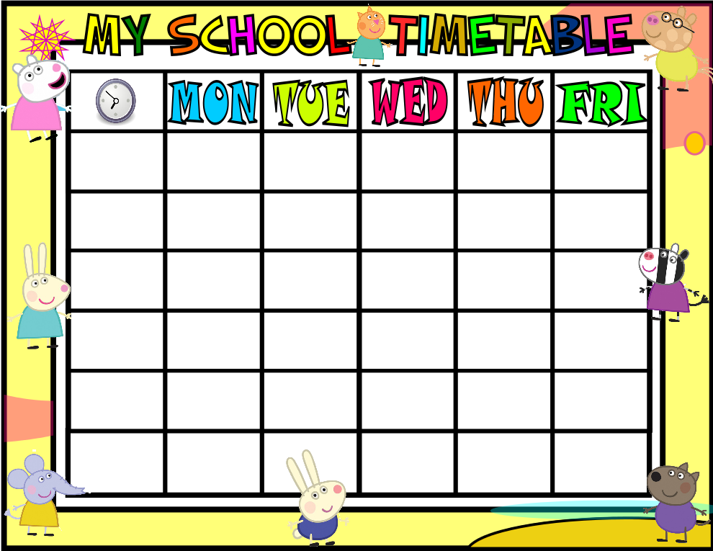
When do we have P.E.?
English
P.E.
English
P.E.
We have P.E. on Thursday.
English
P.E.
What do we have on Monday?
We have English.

Slide 9
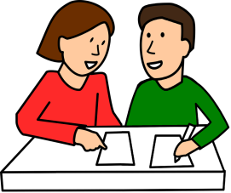

Look and say.
+ What do we have on Tuesday?
=> We have …
+ When do we have …?
=> We have … on …
Pair work

Slide 10
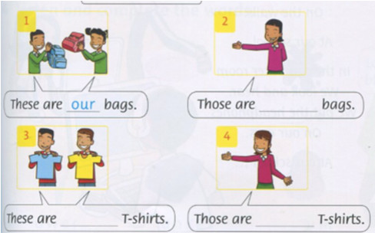
Write
Our/ their
their
our
their

Slide 11
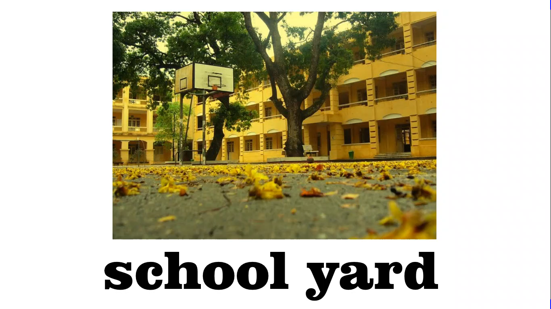

Slide 12
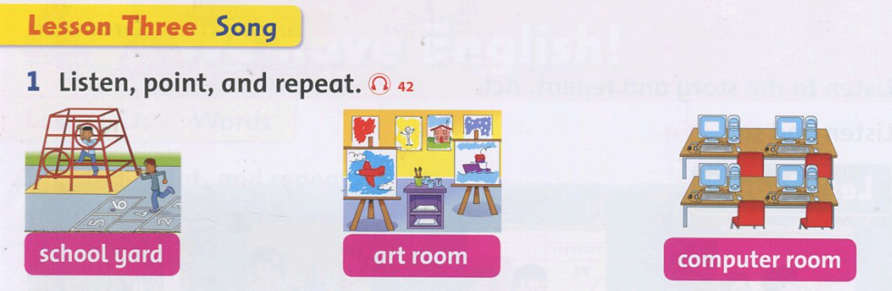

Slide 13
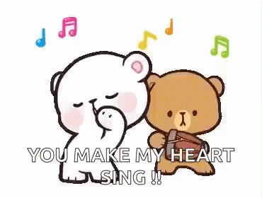
Listen and sing

Slide 14



