Slide 1

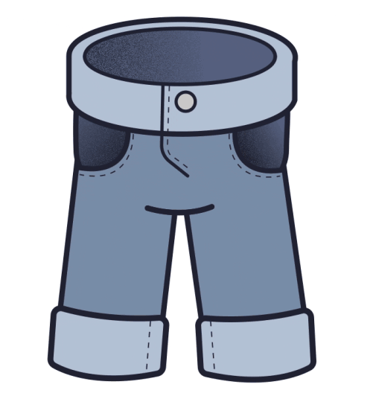
Grade 2
Unit 3
Are these his pants?
Lesson 4

Slide 2

Listen and point

Slide 3


Slide 4

Listen and repeat

Slide 6
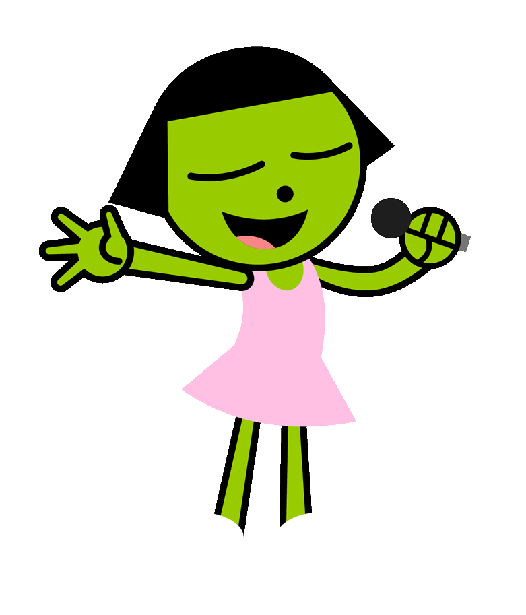
Listen and sing

Slide 9

It’s play time!

Slide 10
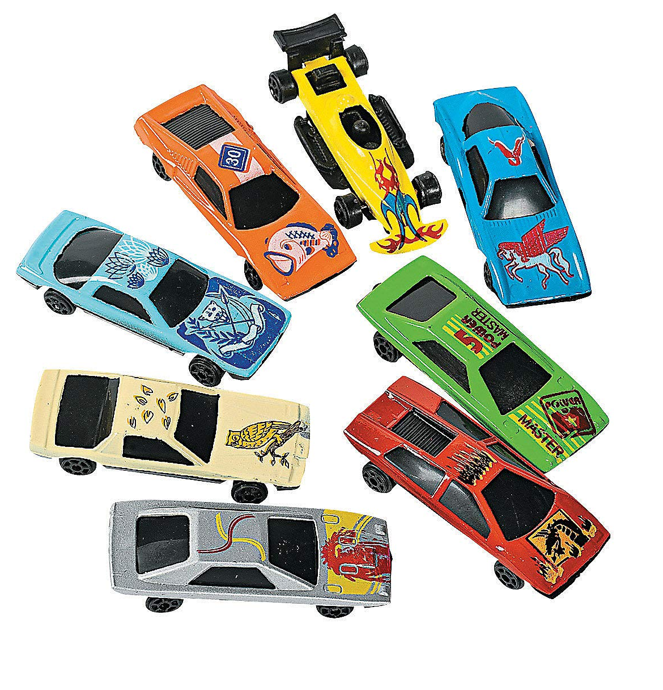
twelve
eight
one

Slide 11

five
three
nine

Slide 12

nine
two
three

Slide 13

ten
fourteen
thirteen

Slide 14
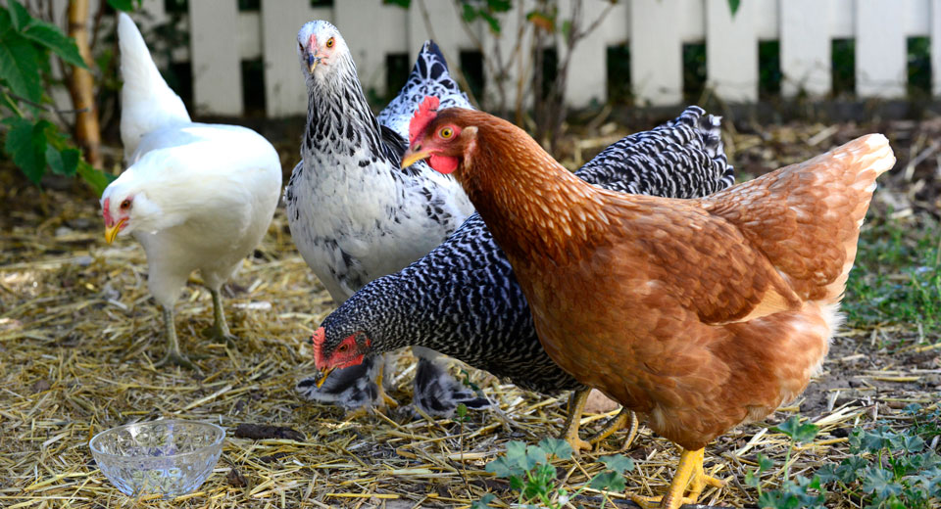
Count and choose the correct number
six
four
fourteen

Slide 15
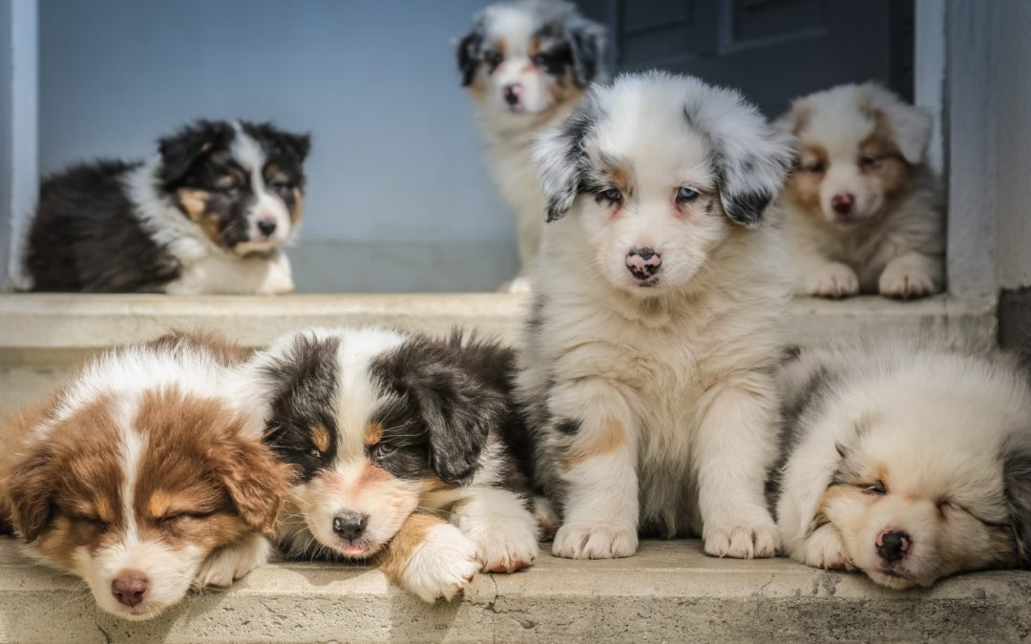
seven
eight
eleven

Slide 16

fourteen
nine
five

Slide 17
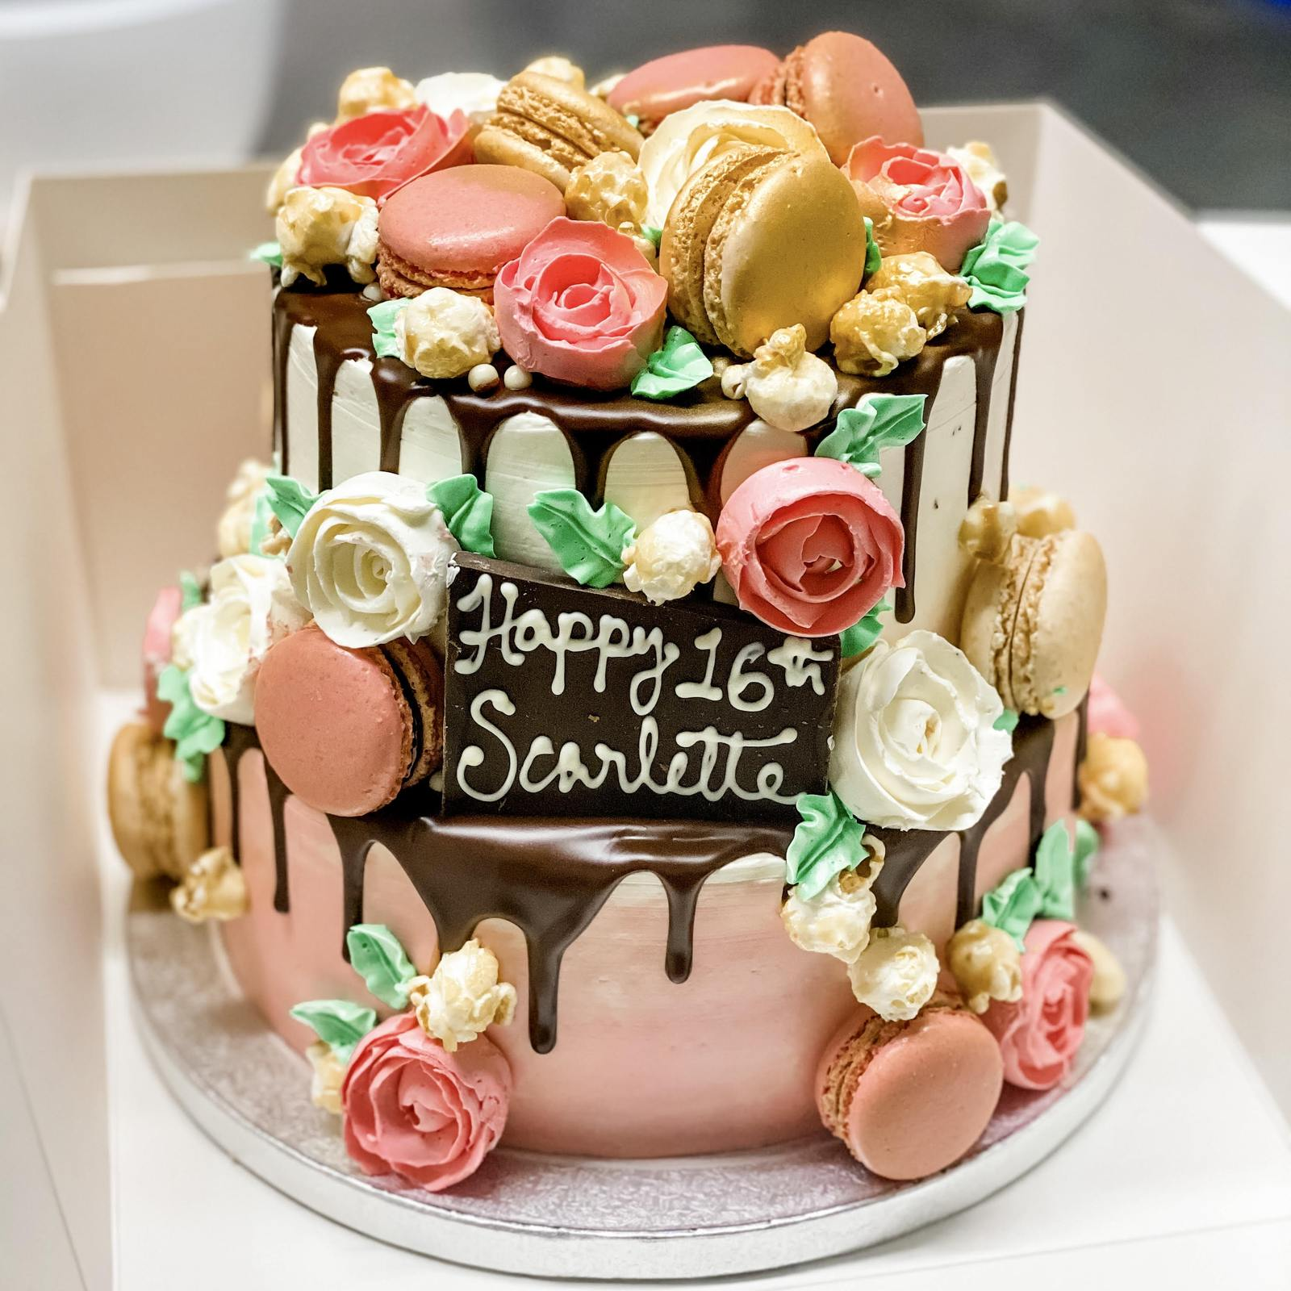
two
one
six

Slide 18
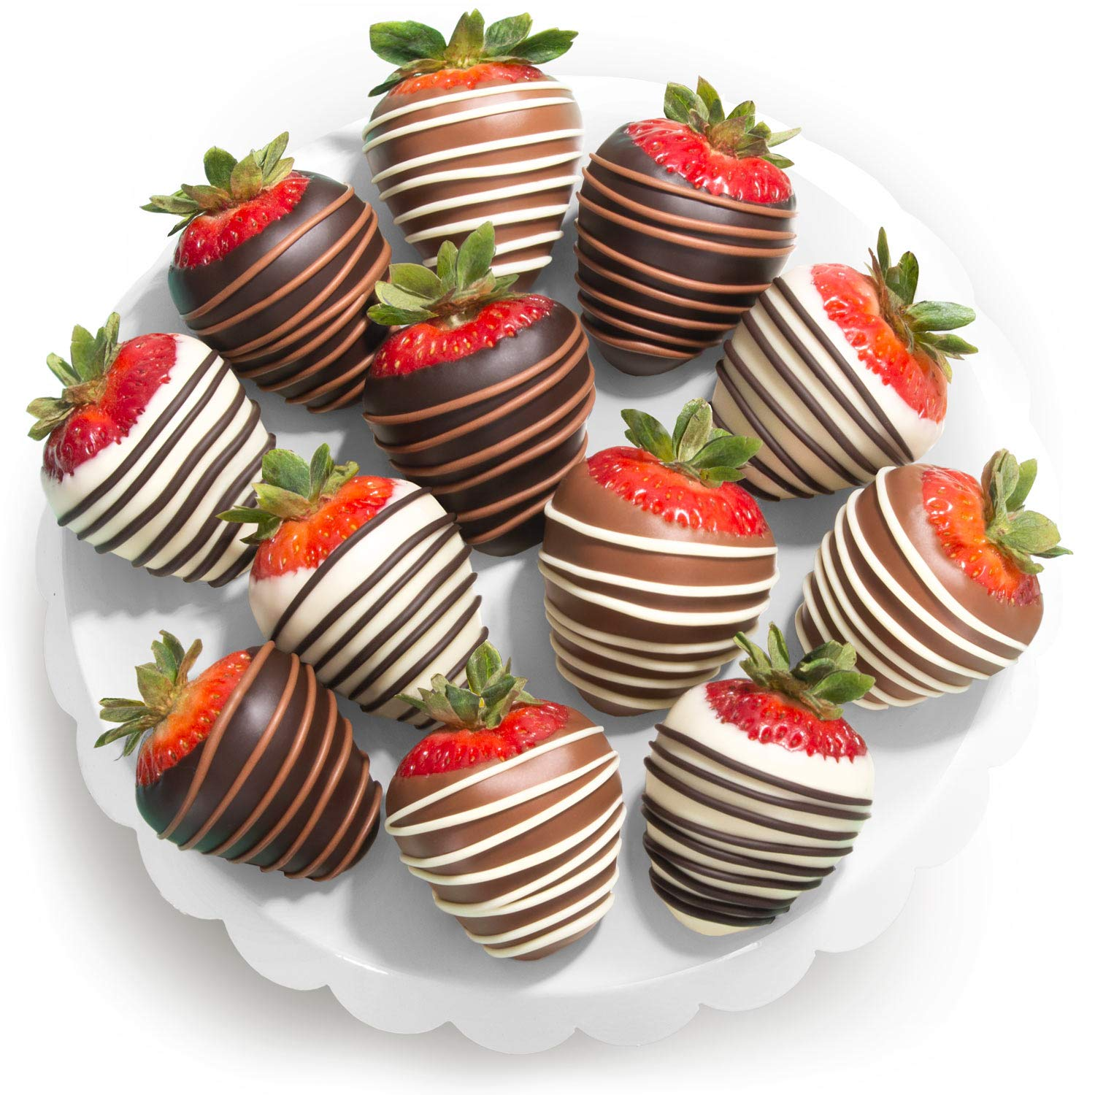
nine
twelve
thirteen

Slide 19

seven
three
five

Slide 20
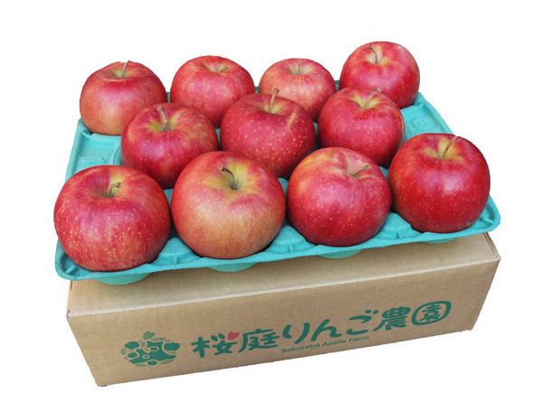
ten
eleven
thirteen

Slide 21
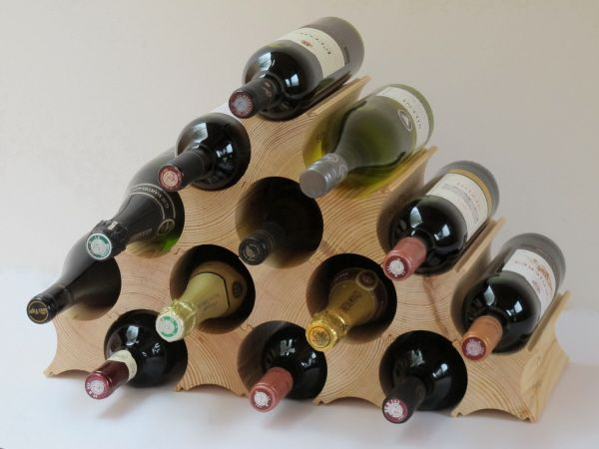
eight
thirteen
twelve

Slide 22
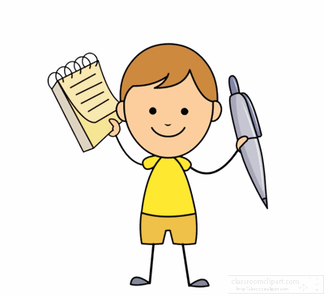
Workbook time!!!

Slide 23
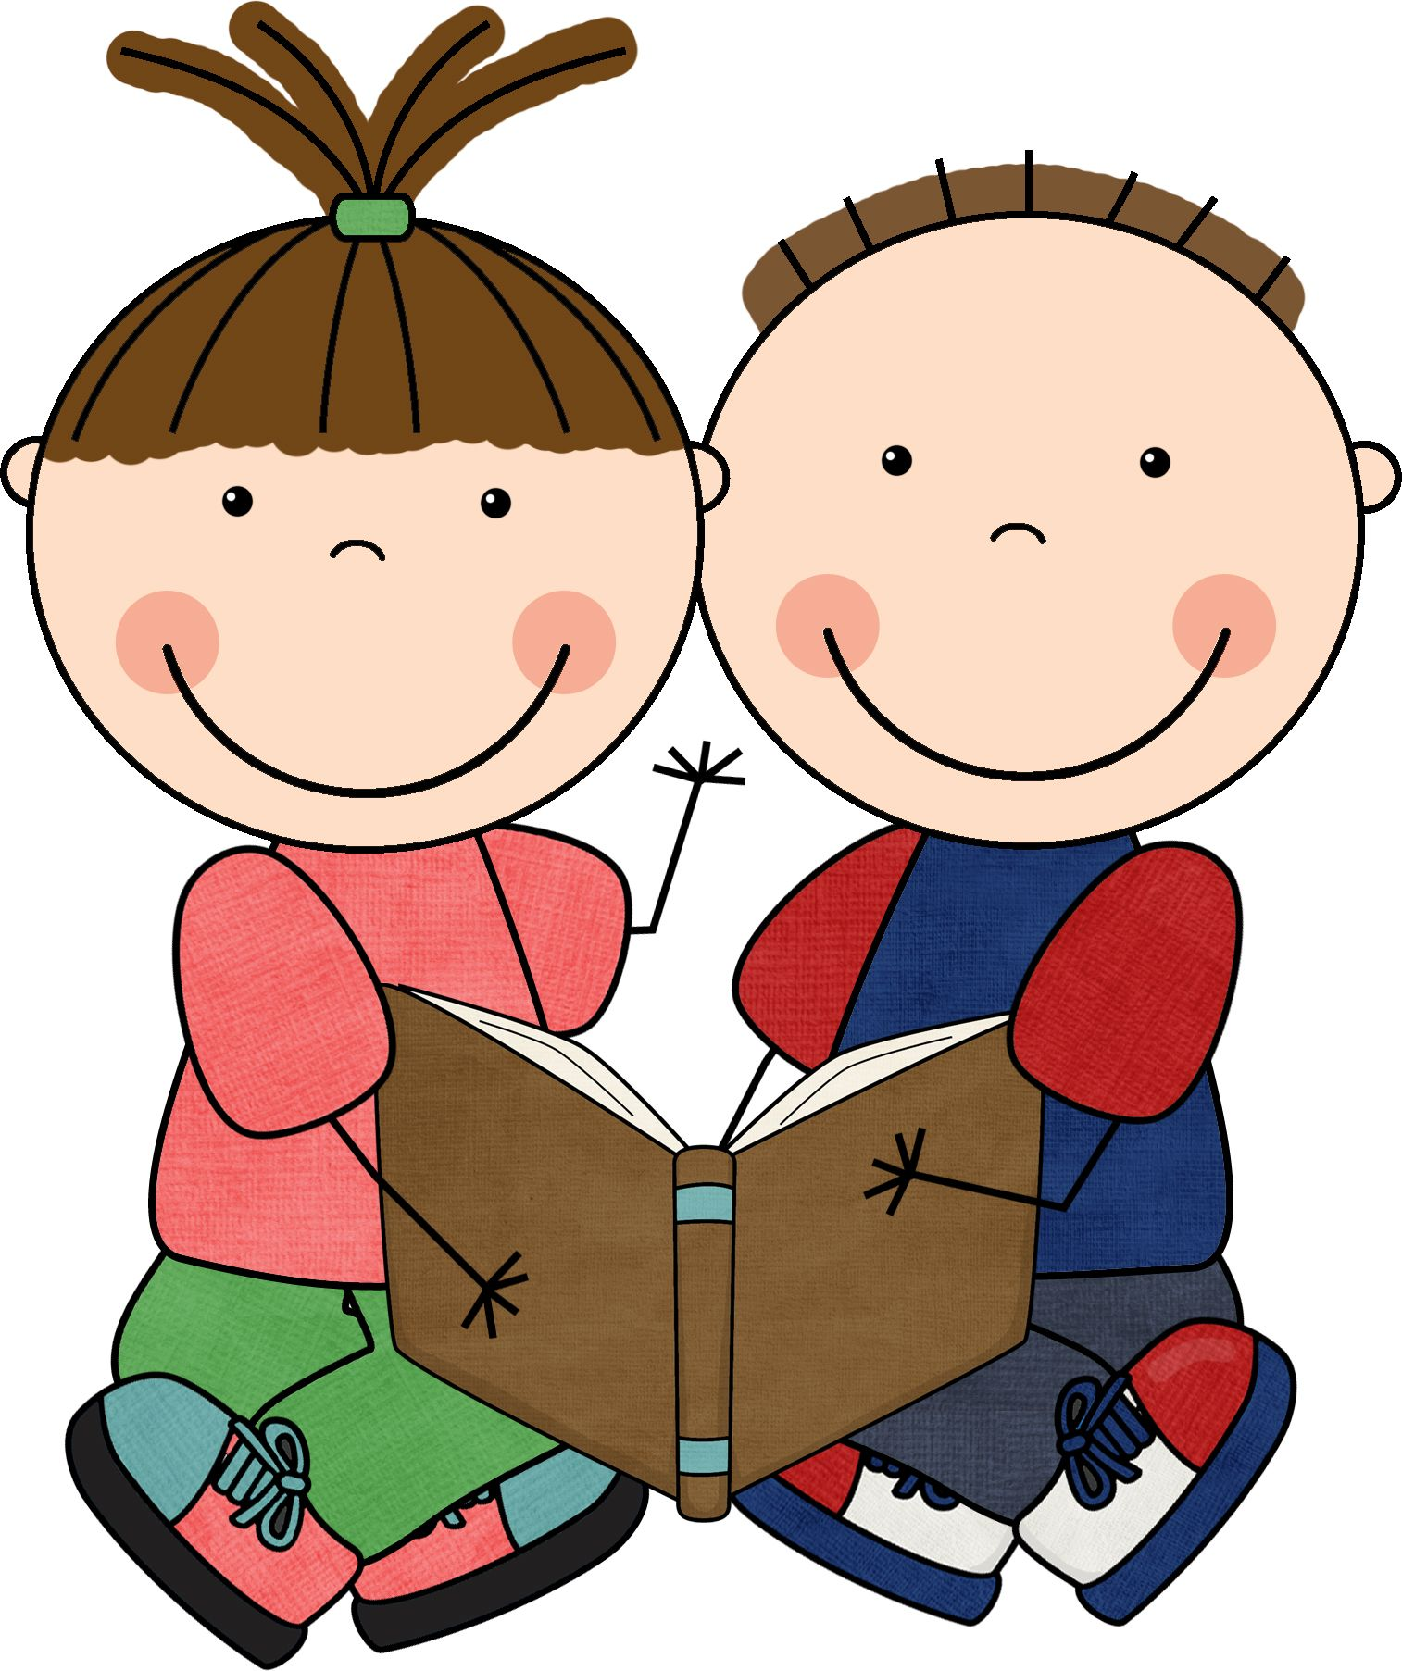
Work in pairs

Slide 24
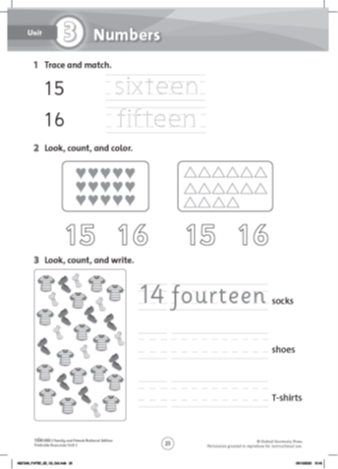

Slide 25


