Slide 1
Unit starter:
Grade 4
Lesson One
This Photo by Unknown Author is licensed under CC BY-SA-NC

Slide 2
It’s time for a game!

Slide 3
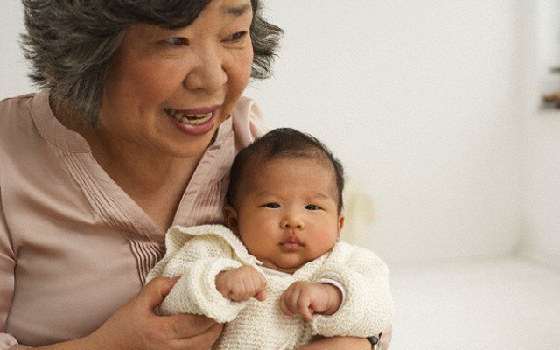
g
r
a
n
d
m
a
Q
W
E
R
T
Y
U
I
O
P
A
S
D
F
G
H
J
K
L
Z
X
C
V
B
N
M

Slide 4
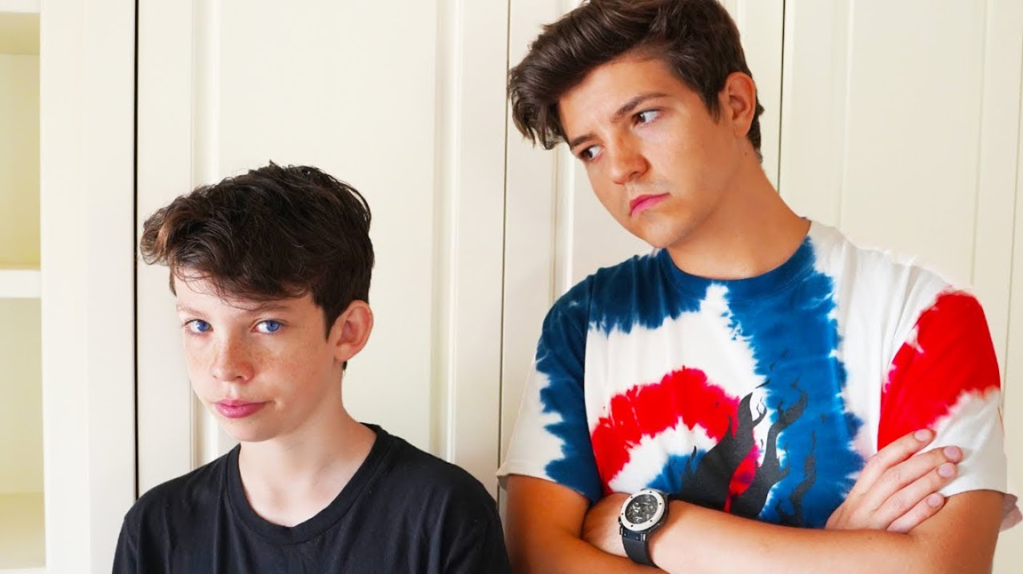
b
r
o
t
h
e
r
Q
W
E
R
T
Y
U
I
O
P
A
S
D
F
G
H
J
K
L
Z
X
C
V
B
N
M

Slide 5
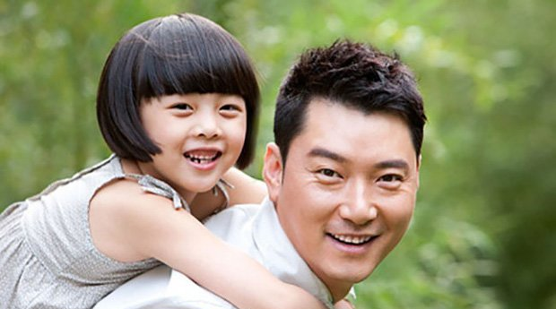
d
a
d
Q
W
E
R
T
Y
U
I
O
P
A
S
D
F
G
H
J
K
L
Z
X
C
V
B
N
M

Slide 6
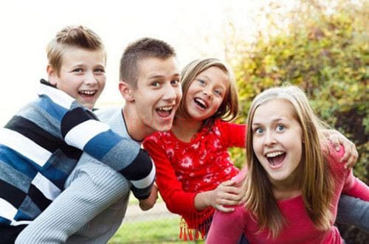
c
o
u
s
i
n
Q
W
E
R
T
Y
U
I
O
P
A
S
D
F
G
H
J
K
L
Z
X
C
V
B
N
M

Slide 7
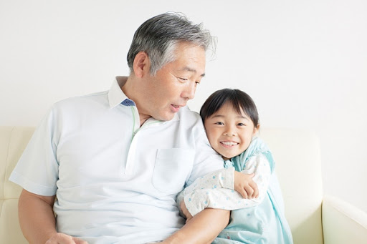
g
r
a
n
d
p
a
Q
W
E
R
T
Y
U
I
O
P
A
S
D
F
G
H
J
K
L
Z
X
C
V
B
N
M

Slide 8
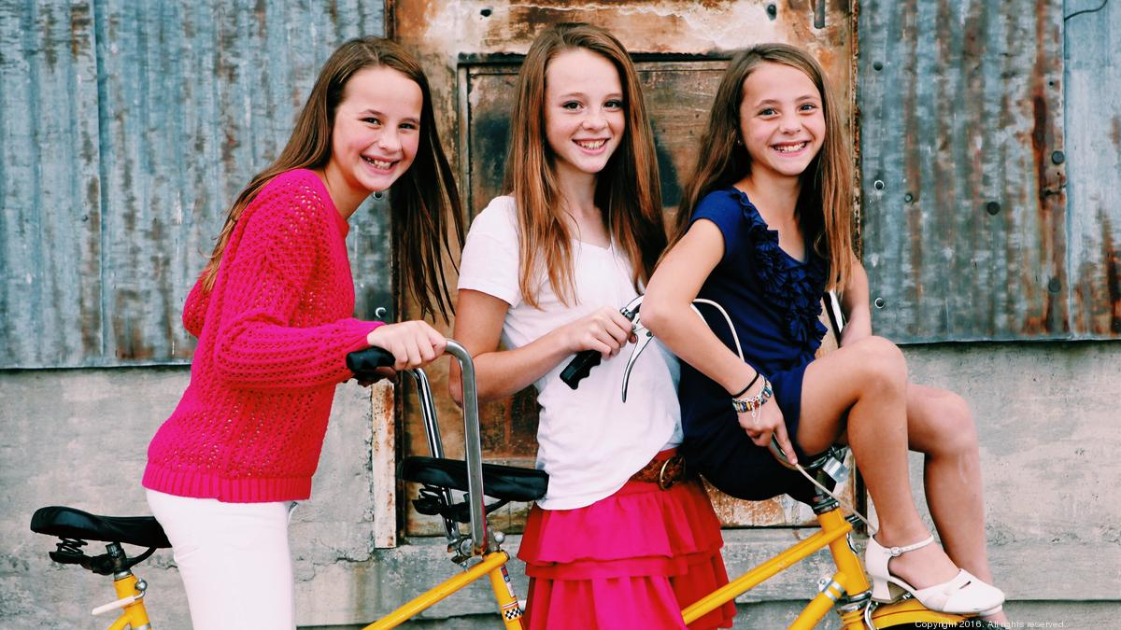
s
i
s
t
e
r
Q
W
E
R
T
Y
U
I
O
P
A
S
D
F
G
H
J
K
L
Z
X
C
V
B
N
M

Slide 9
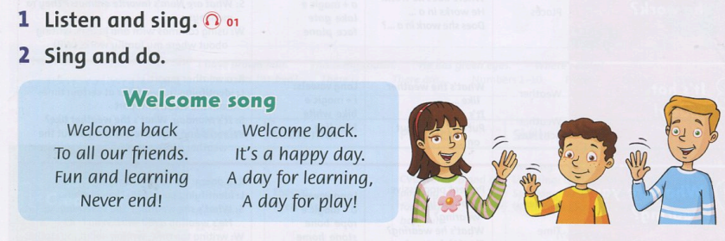

Slide 10
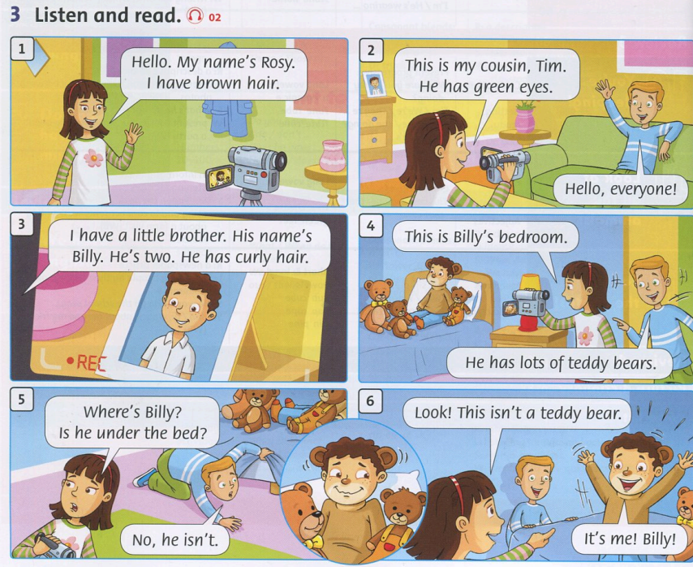

Slide 11
Tasks: Work in groups
Roleplay

Slide 13
Monday, September 4th, 2021
Unit : Stater
New words:
Have
I, You ,We , They
Has
He, She
-cousin :
Anh em họ
-curly :
xoăn
-under :
dưới
-little:
nhỏ
-hair:
tóc
-lots of:
nhiều

Slide 14
Goodbye~!

